Slide 1
DSP FILTER ALGORITHMS ON FPGA

Slide 2
Feb 10 : Project topic finalization
Feb 17 : Research for relevant filters to be implemented
Feb 20 : Verilog implementation
Feb 25 :
VGA signal synchronization problems
Mar 5 : Suggestion from Prof. Sikka to use HDL CODER
Mar 6 : Extensive research on HDL CODER
Mar 9 :
FIR Filter design by hard coding followed by using the FDA tool
Mar 10 :
FIR Filter generation using HDL Coder and simulation, but failed synthesis

Slide 3
Mar 21 :
Started study on LMS Adaptive Noise Cancellation Filter
Mar 28 : Started working on VGA implementation using Verilog to display filter weights
Apr 2: Implemented Matlab code for noise canceller and tested using sample data input.
Apr 20 : Implemented basic VGA but with some errors displaying negative values
Apr 21 : Designed LMS filter model in Simulink with an aim to work on FPGA in Loop
Apr 15 :
HDL CODER crashing in the process of conversion of Verilog code generation
Apr 17 :
Prof. Sikka suggests to reduce number of input input data samples for HDL Coder function input.
Apr 22 :
FPGA in loop implementation failed after repeated attempts.

Slide 4
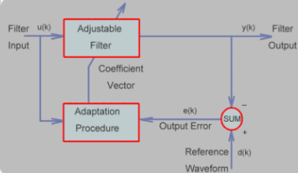
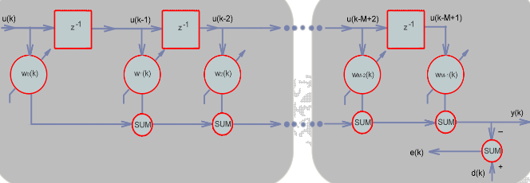
LMS Filter Block Diagram

Slide 5
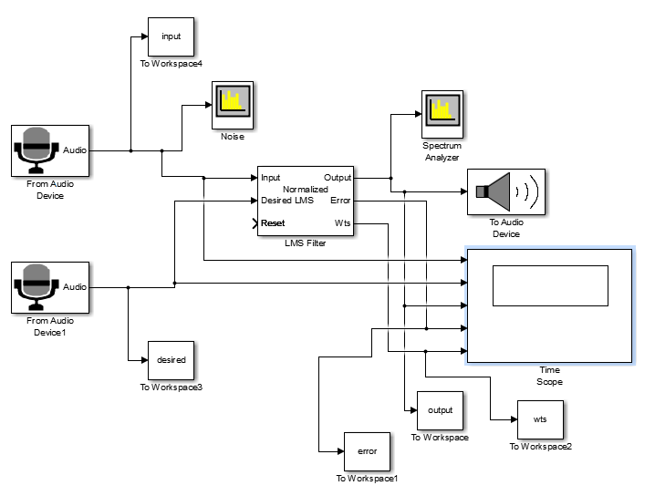
LMS SIMULINK MODEL IMPLEMENTATION

Slide 6
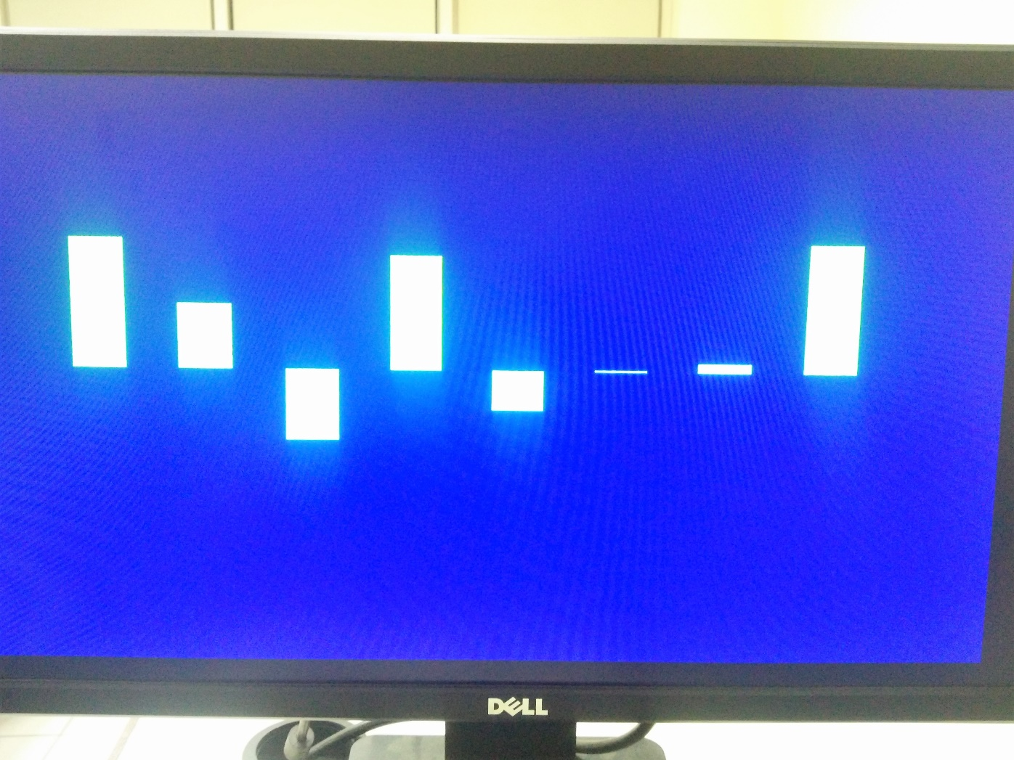
VGA Output

